Slide 1
#PTMF Pt.2 Every day is Friday
Björn Sundling

Slide 2

Many thanks to our sponsors:

Slide 3




Björn Sundling
Azure (&) DevOps consultant @ Advania
MVP – Developer Technologies
Write stuff: bjompen.com
Create stuff: Github.com/bjompen
Share stuff: mastodon.nu/bjompen
Walk stuff:
Play stuff:
Cook stuff:

Slide 4
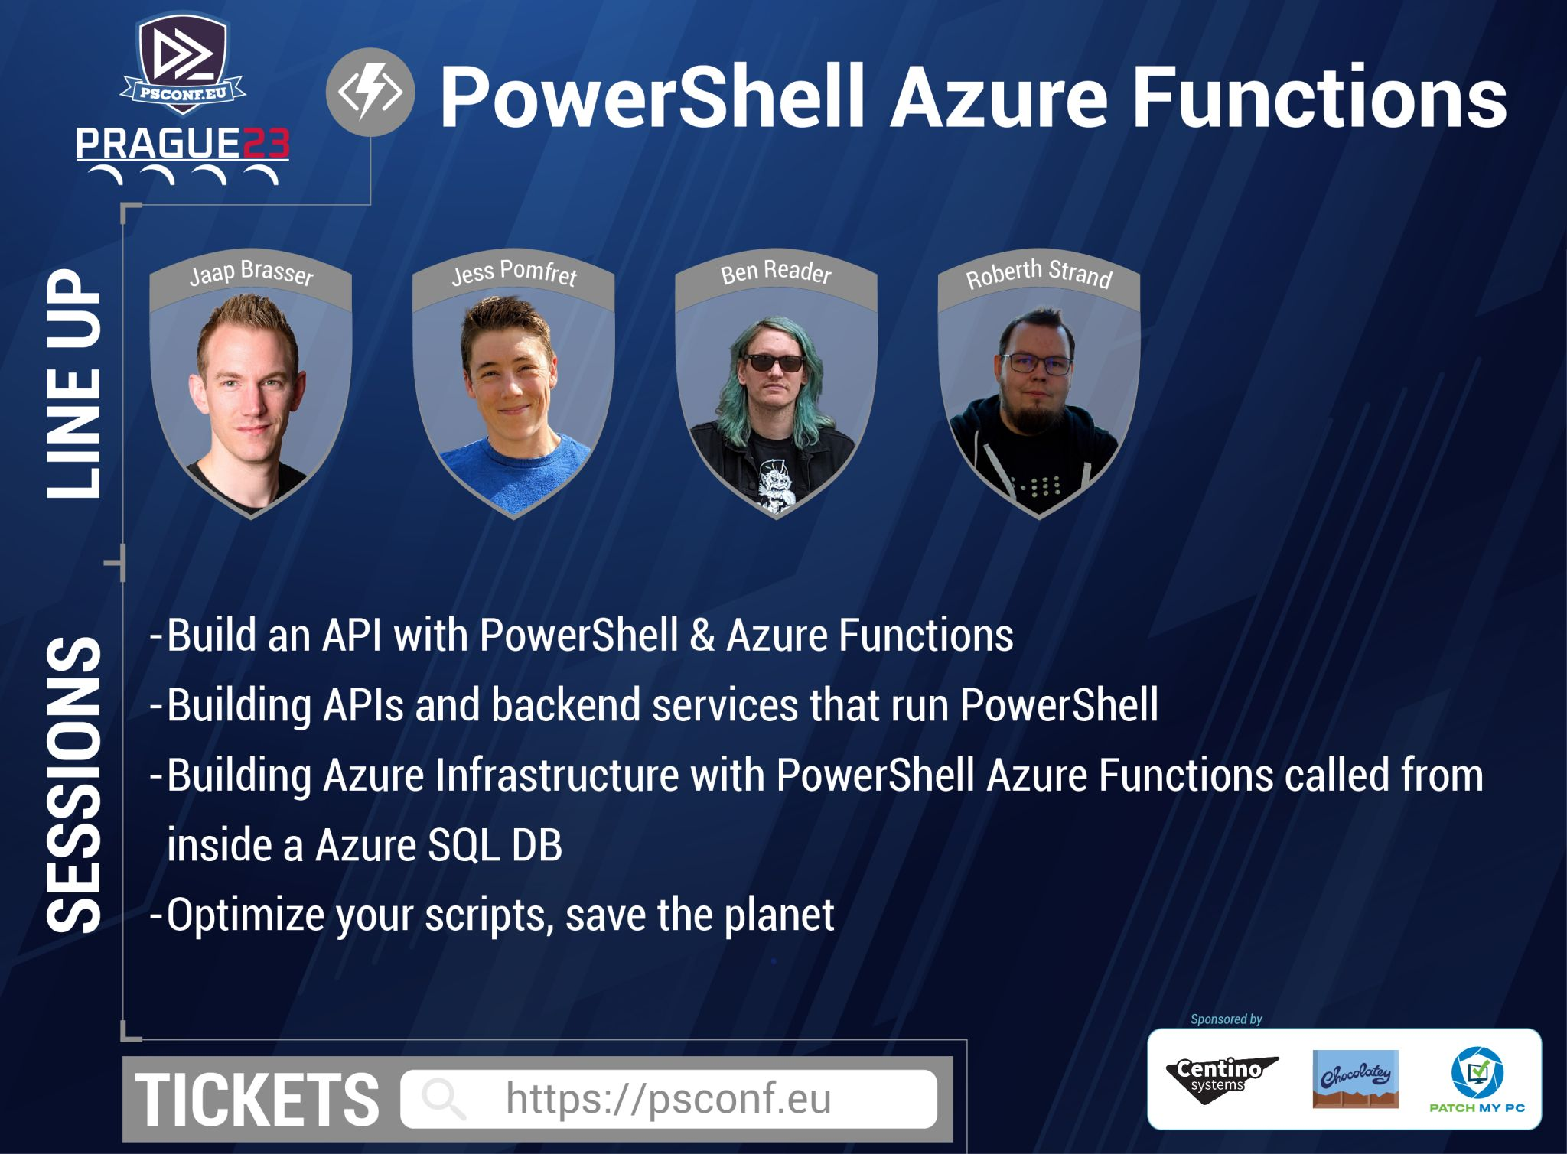
Agenda
#PTMF? LMGTFY!
Deploying an Azure Function!
Build
Set up infrastructure
Dev – Test – Prod (minus the dev..)
Notes:
So the agenda for today looks a bit like this.
We will be deploying an azure function. How those works, and how we can use them is not a part of this session, but it is a good scenario for PowerShell people.
Care to learn more about those, here are some sessions.
As for us:
Three steps will be added to our deploy, but now we’re talking a lot more code.
We’re going to build out code, and talk about why that’s important
We’re going to add infrastructure, and run integration tests against ephemeral and short lived environments
And last but not least, we will deploy to our production environment and add some basic traceability.

Slide 5
#PTMF?
Push to main-Fridays
Notes:
PTMF – Push to main Fridays: Some backstory goes here
Never deploy on Fridays? Make every day a Friday!

Slide 6
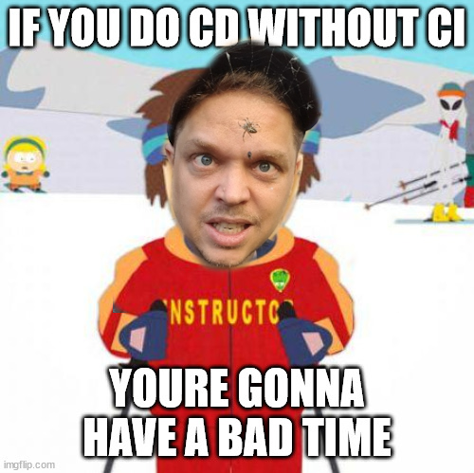
#PTMF?
Linter
Pester
Security scanning
Notes:
Before we start, lets look at where we start from.
https://dev.azure.com/bjornsundling/PSConf2023-PTMF2/_git/1.Start
Before we go look at deploying I can’t stress enough that you should have some things in place before deploying:
Proper test coverage.
Linters, security scanners and other code validations
Git strategy. Needed for designing.
If not *CLICK*
You will end up releasing bad stuff faster
FOCUS OF TODAY - Stability, repeatability, frequency
That said, lets head on in to the fantastic world of #PTMF part 2: the CD part of a pipeline.

Slide 7
Demos
Build scripts!
Notes:
Stability, repeatability, frequency
Why do we build?
Compile if necessary
Long lived package. We need to know we run the exact same build through every step of our dev/test/deploy
Last chance to verify everything “inside” my code is good.
Code reviews
Unit tests
Static code analysis - Linters
Tag packages. Version, date, or anything else.
Invoke-Build
Set version numbers using gitversion
Test before build
Run linters again
Combine to one artifact / folder
Test after build
On multiple host operating systems
I use invoke-build by Roman Kuzmin, nightroman, mainly because I’m used to it, but in all honesty, the basic functionality you should have can even be done by hand.
Invoke-build has a less desirable feature:
If run in a console it always exits the process when run. As in it kills the powershell session.
Cd C:\AzureDevOps\bjornsundling\PSConf2023-PTMF2\2.BuildScript\
pwsh -c {Invoke-Build}
C:\AzureDevOps\bjornsundling\PSConf2023-PTMF2\2.BuildScript\Tools
gitversion.exe /?
gitversion.exe – 0.2.0
gitversion.exe /config ../GitVersion.config.yml – 2.0.0
Building separate projects – many smaller projects in one repo
Incremental builds using git
git diff HEAD HEAD^ --name-only

Slide 8
Demos
Got infra?
Notes:
Stability, repeatability, frequency
https://dev.azure.com/bjornsundling/PSConf2023-PTMF2/_git/3.GotInfra
https://dev.azure.com/bjornsundling/PSConf2023-PTMF2/_git/3.GotInfra.Function
Idempotency in hardware – Use Bicep to deploy the same infra to dev/test/prod.
Same templates in all environments.
Variables allows us to keep production up. Nothing will change as long as the templates stays the same -> Lock version using git tags
Keep it separate – Make it reusable!
Save your dependencies. Downloading them takes time and may lead to unexpected configurations if you don’t specify dependency versions.
Why including modules may be good? (DeploymentModules folder)
Run integration tests against ephemeral and short lived hosts – no more configuration drifts in test environment
Also the place for performance testing – Azure load testing
If performance is bad, break the pipeline, save the test environment and explore
Run on VMSS – Managed identity
https://learn.microsoft.com/en-us/azure/devops/pipelines/process/templates?view=azure-devops
Tagging images – why latest is bad https://vsupalov.com/docker-latest-tag/

Slide 9
Demos
Dev / Test -> Prod!
Notes:
Stability, repeatability, frequency
https://dev.azure.com/bjornsundling/PSConf2023-PTMF2/_git/4.Test.Prod
Why do we do dev/test/prod?
Finding errors early
Shift left
Add parameters, if statements, and evaluations to deploy the same to prod
Idempotent infrastructure allows you to always have it up without changes
Branch strategy – release branch
Using gateways.
Use extends templates to enforce security and add requires templates in Azure DevOps
Automatic creation of change requests?
CAB boards are bad -> Delivery allows for pipeline to be stopped for manual deploy, Deployment do not.
Zero downtime deployment? Blue/green using for example deployment slots in Azure Functions, Azure traffic manager, or APIM
Smoke tests are run in this setup
Or hardcore push to Prod and restart azure function.

Slide 10
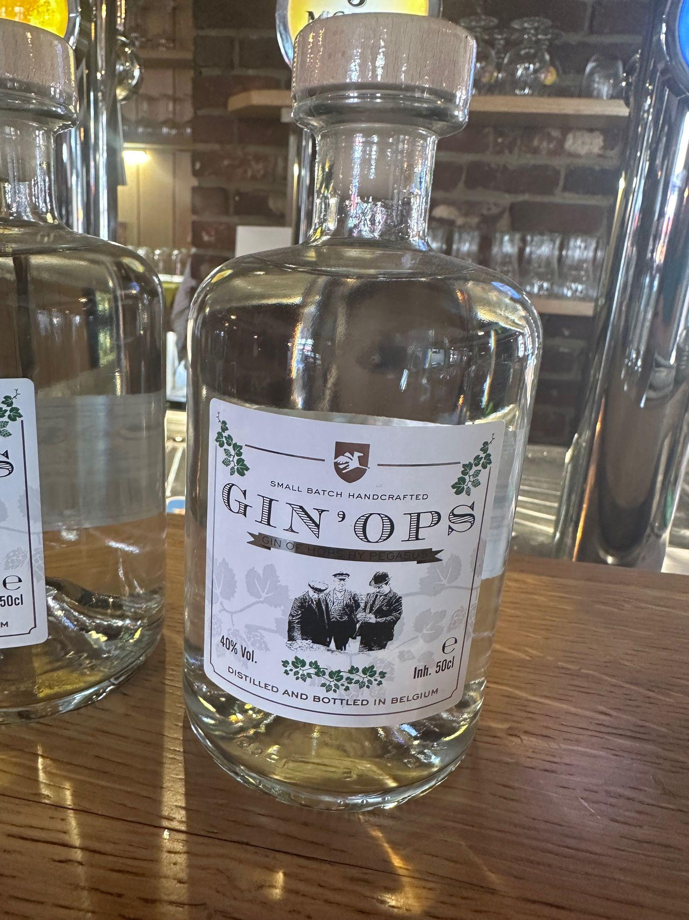
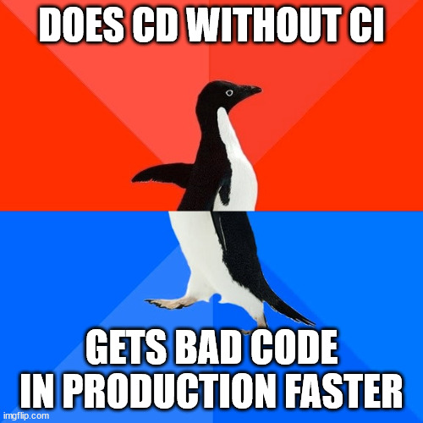

#PTMF? #PTMF!
STABILITY
REPEATABILITY
FREQUENCY
Notes:
Stability
Proper testing
Linters
Unit tests –in CI and CD / built *CLICK*
CD – Integration tests against the build in production
Repeatability
Everything is scripted and automated
Published artifacts
Idempotence, Templated infrastructure
Frequency is a consequence, not a starter point! Once you have the other two, focus on making things faster
As for right now *CLICK*
Everyday is Friday and instead of thinking about DevOps, we can focus more on GinOps.

Slide 11
Q&A

Slide 12
Demos
We love Demos!

Slide 13
#PTMF?
sad

